Slide 1
South Wirral High School

Slide 2
The Duke of Edinburgh (DofE) Award Information for Parents
What is it?
Why do it?
What will I experiences will I gain?

Slide 3
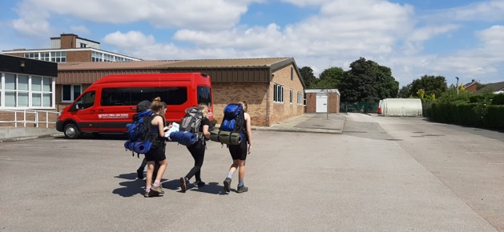
What is the DofE Award?
The Duke of Edinburgh Award website describes it as
“A life-changing experience. A fun time with friends. An opportunity to discover new interests and talents. A tool to develop essential skills for life and work. A recognised mark of achievement; respected by employers”
Anyone can do it!!

Slide 4
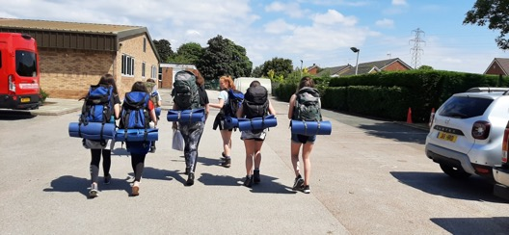
What is DofE?
There are three different levels that you can do depending on how old you are
Bronze – year 9
Silver – Year 10/year 11
Gold – Year 12 and 13
And how long it takes to complete may depend on your previous experiences of DofE.

Slide 5
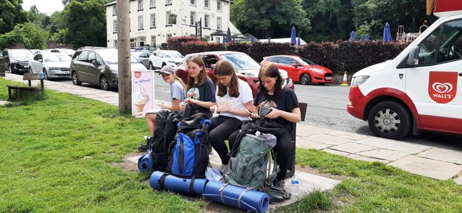
Bronze DofE
6
You can start this in year 9
There are 4 sections to complete
Volunteering, skills, practical and finally your expedition which is 2 days and 1 night camping.
Each section (apart from the expedition) takes 3 months although you do have to pick one of the sections to complete over 6 months.

Slide 6
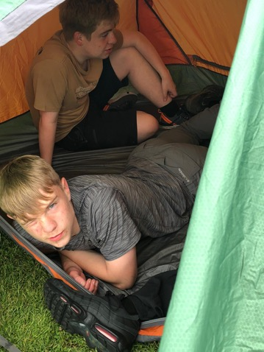
Silver DofE
6/12
You can start this in year 10 or 11 (this year).
There are 4 sections to complete
Volunteering, skills, practical and finally your expedition which is 3 days and 2 nights camping.
If you have already completed Bronze, each section (apart from the expedition) it will take you 6 months to complete. You have to volunteer for 6 months, and the pick either skills of practical to complete over 6 months, the other for 3 months.
If you have not completed the Bronze award you will have to do a further 6 months in volunteering or the longer of the skills or practical section

Slide 7
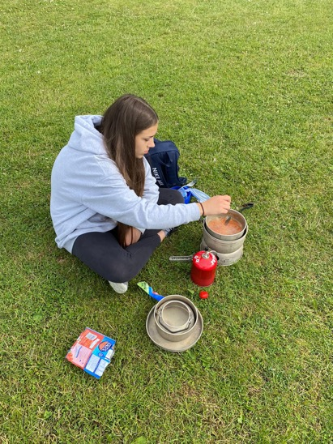
Gold DofE
12/18
You can start this in year 12
There are 5 sections to complete
Volunteering, skills, practical and finally your expedition which is 4 days and 3 nights camping and an additional residential section (5 days and 4 nights).
If you have already completed silver, each section (apart from the expedition) it will take you 12 months to complete. You have to volunteer for 12 months, and the pick either skills of practical to complete over 12 months, the other for 6 months
If you have not completed the Silver award (even if you have done bronze) you will have to do a further 6 months in volunteering or the longer of the skills or practical section (totalling 18 months for one section).

Slide 8
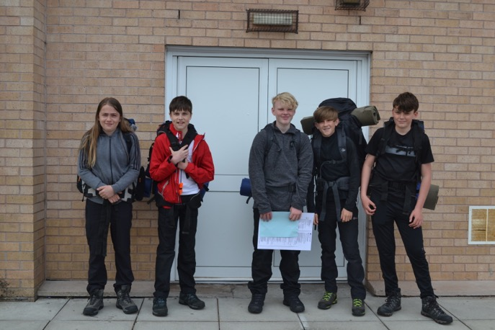
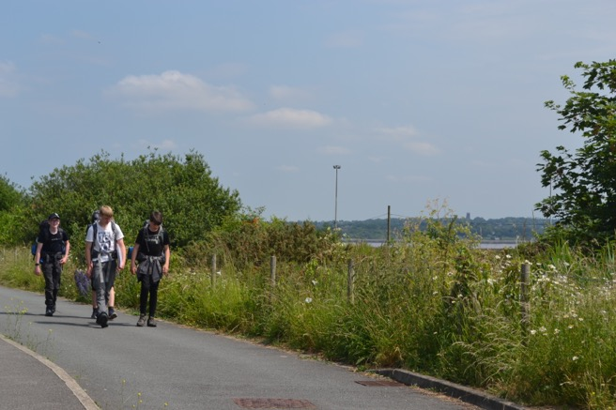
The Expeditions
The expeditions are perhaps the most demanding aspect of the award.
It is worth trying to complete all of the other parts of your award before your start your expedition.
Bronze
The practice expedition is 1 day and the qualifying expedition is 2 days with an overnight stay.
Each day the pupils will walk around 16km.
Silver
The practice and qualifying expeditions are 3 days each with two overnight stays.
Each day pupils will walk about 19km.
Gold
The practice and qualifying expeditions are 4 days with 3 night stays. Each day the participants will walk around 23km.

Slide 9
How Do I Prove What I Have Done?
Once you are signed up, you receive a booklet and a eDofE log in.
Each of the 4 sections have a evidence sheet that will have to be completed by your assessor. This will be someone who has taught/observed you as part of your section, e.g. football coach, music teacher, manager at charity shop and then your expedition leader. It cannot be a parent or family member.
This can be done electronically or in your DofE booklet and scanned in.
You are responsible for sorting out your placements for skills, practical, and volunteering and we sort out your expedition.
You can also add evidence yourselves e.g. pictures, running logs, diaries.
Its your eDofE to take ownership of.

Slide 10
How Will It Benefit Me?
Learn New Skills
Make New Friends
Skills that employers value
Make a difference
Healthier
Improves confidence
Help someone out
Looks good on C.V and education applications

Slide 11
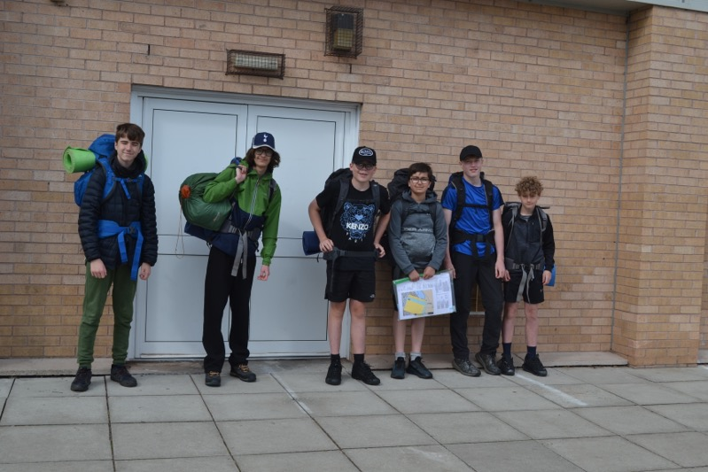
What Will I Need To Complete the Award?
Dedication and commitment
Confidence – although this will improve throughout
Initiative
Problem solving
Team work
Communication
Independence

Slide 12
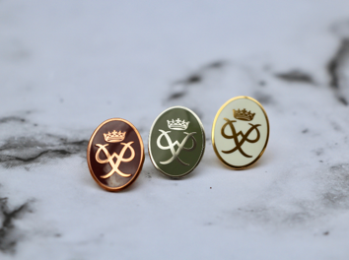
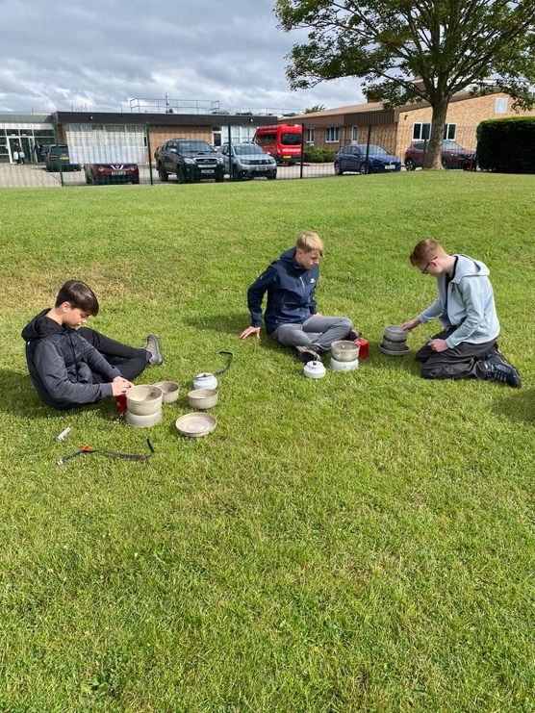
What Do I Get?
A certificate
A badge (additional cost)
A invaluable experience to put on your c.v. or college applications
An improvement of many skills you will use all through your lifetime
An amazing experience
Gold award – presented at Buckingham palace by royalty and/or celebrities.

Slide 13
How Can We Sign Up?
If you have already signed the interest sheet, a letter will be given to you. If not you need to collect a letter from Mrs Dennis in student services.
You must return the letter attached to the information pack to Mrs Dennis in student services by October half term to be signed up.
We will then create their online profile and send their log in details so they can get started.

Slide 14
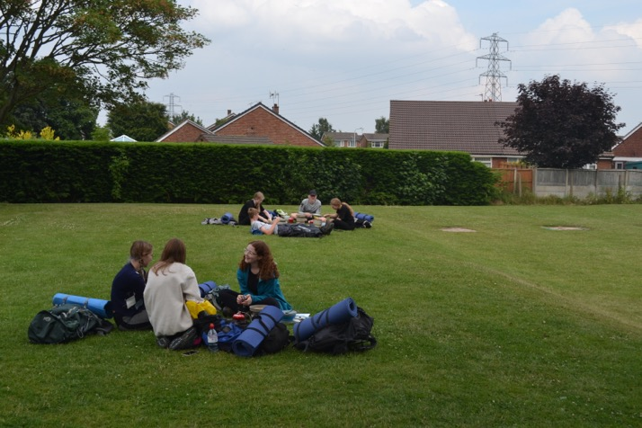
The DofE App
The app makes it easier to add evidence and photos. It’s easy to upload your assessors reports when you have taken a photo of them (even though you are at home, these still cannot be done by parents or family).
You can take your profile around with you and catch photos of you in action!

Slide 15
Cost
 | Admin cost | Expedition | Time
Bronze | £23.50 | Approx £200 | 1 night 2 days
Silver | £23.50 | Approx £300 | 2 nights 3 days
Gold | £32 | Approx £400 | 3 nights 4 days
Each award has its costs
A sign up administration fee which goes to DofE
The expedition costs also include a training expedition which is necessary for all levels. Pupils must attend both the training and actual expedition in line with the risk assessments in place. (Last year due to changes and covid, the costs were dramatically reduced. We are hopefully camping next year so costs will be back to normal.
Additional expenses to consider:
We will provide tents, bags and cooking equipment
Pupils will need suitable walking boots and waterproof clothing, sleeping bags, food, and a few other essentials.
Once you are signed up you do a discount card to help with the cost of equipment
There is a full example kit list you may wish to look at on the DofE website before you sign up
https://www.dofe.org/shopping/wp-content/uploads/2020/01/Expedition_Kit_List-Jan-2020.pdf

Slide 16
Proposed Expedition Dates
We are endeavouring to put expeditions on during school holidays and weekends. Last year (before covid rearrangement) they were planned for February half term and the Easter holidays.
The proposed dates at the minute are (may subject to change).
Bronze – 12th -13th March 2022
Silver – training – 9th – 11th April 2022
qualifying – 29th-30th May 2022

Slide 17
Can My Child Drop Out?
Duke of Edinburgh is such a worthwhile achievement and we are always disappointed when pupils choose to not carry on.
Pupils can stop, however they have until they are 25 to complete the award so they can pick it back up again at a later date.
If they choose not to carry on after they have been signed up, you will still have to pay the enrolment fee.
If they choose to stop after the expedition costs, have gone out, like any trip, you will still have to pay for the expedition as your place will have already been booked.
Please think carefully before your child signs up as it is a big commitment to time and expense.

Slide 18
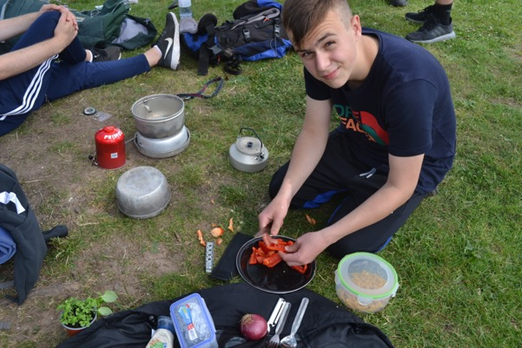
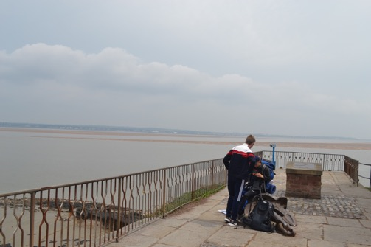
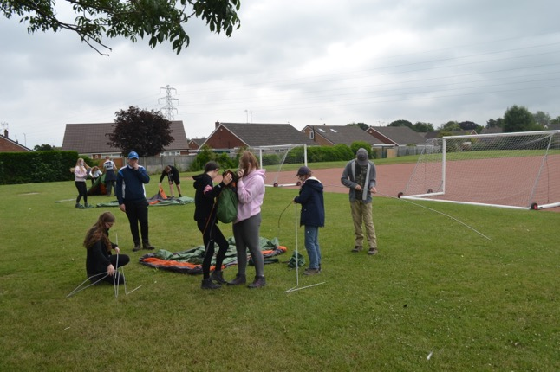
Find Out More!!
https://www.dofe.org/

